Slide 1
Supervised learning capstone
Predicting the trade volumes between countries by using past years data

Slide 2
Overview and problem statement
International trade
Countries and stakeholders can benefit from. Such as Increased revenues, Decreased competition, Longer product lifespan, Easier cash-flow management, Better risk management, Benefiting from currency exchange, Access to export financing, and Disposal of surplus goods.
Problem : shipping customs and duties, language barriers, cultural differences, servicing customers, returning products, and intellectual property theft

Slide 3
Data
This data is from all world pairs of countries (208), for the period 1948 to 206. It would be safe to generalize the results to all counties in the data set.
Total number of rows in dataset = 1204671 Total
number of columns in dataset = 36
Data includes gdp of origin and destination countries
, population , amount of trade between countries etc.
Raw data available here

Slide 4
Understanding the Data
The original data is composed of 1204671 rows and 36 columns.
To analyze the country of interest the USA in a specific time period(year greater than or equal to 2000), the data filtered, and the reduced dataset has 1358 rows and 36 columns.

Slide 5
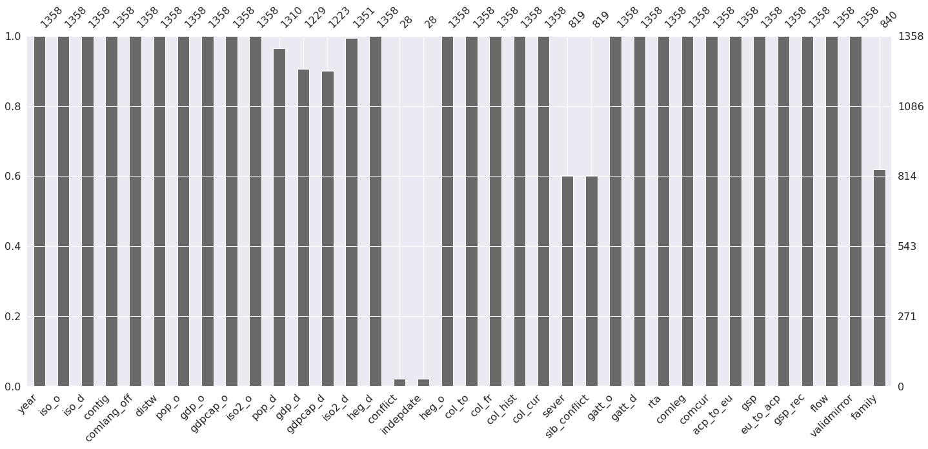
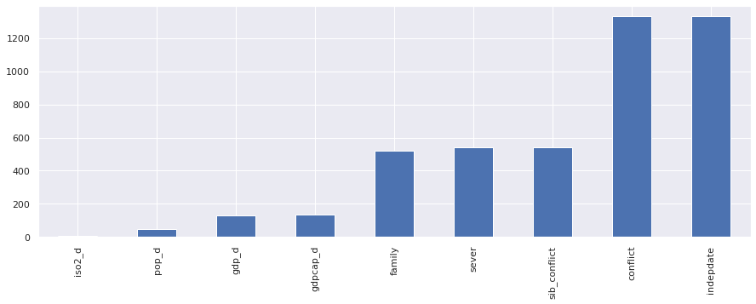
Checking for Missing Values
White spaces shows the missing value in the data frame.

Slide 6
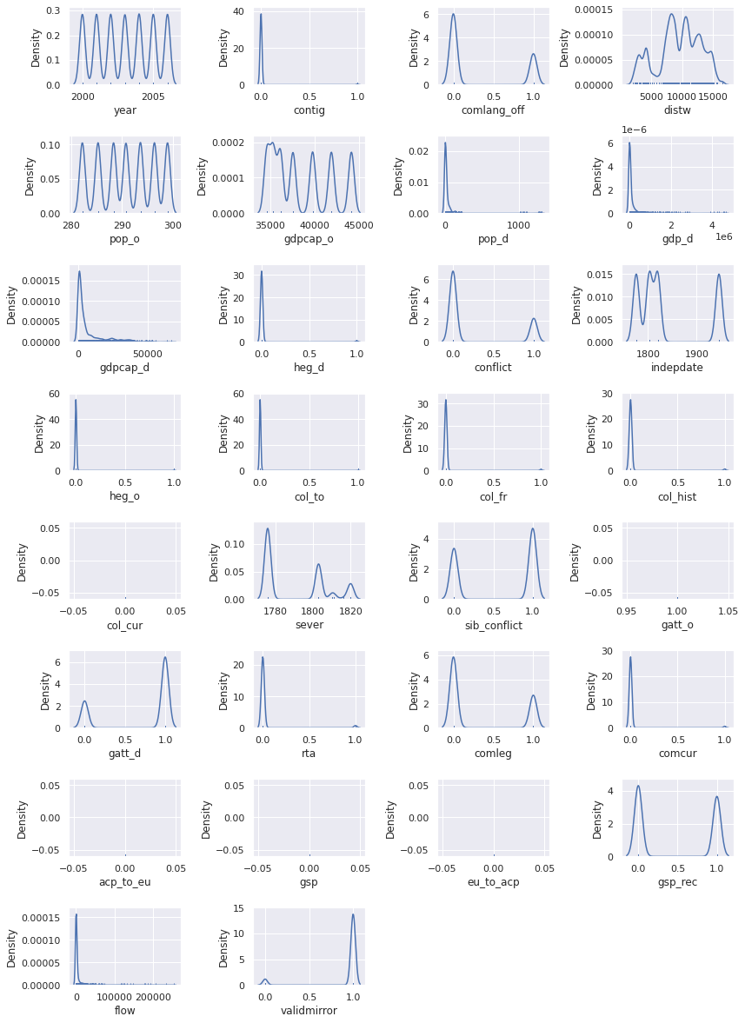
Data Visualization
Distribution plots for list of numerical features

Slide 7
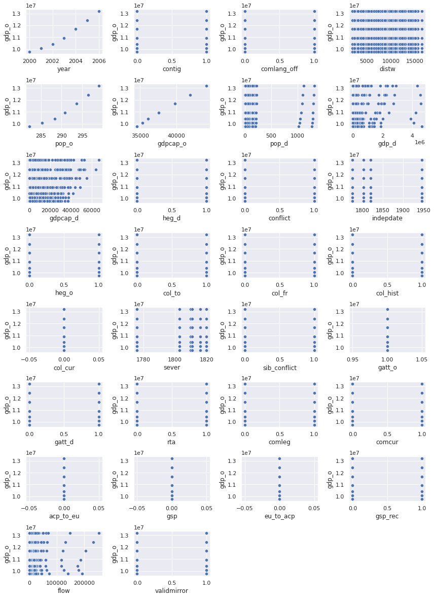
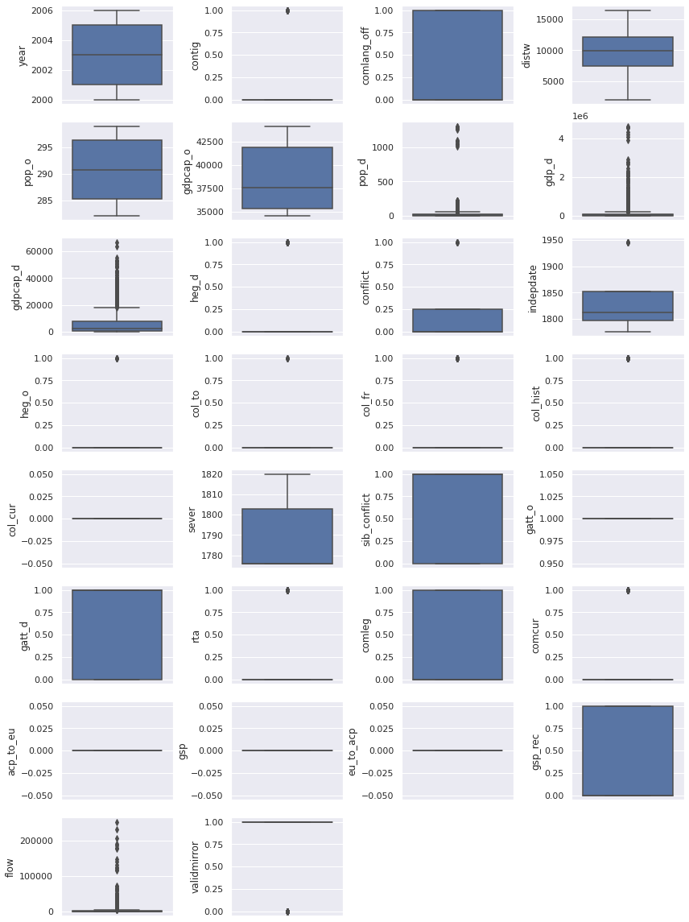
Bivariate and Univariate Analysis
The graph shows that some features like gdpcap_d, pop_d, and flow has outliers.

Slide 8
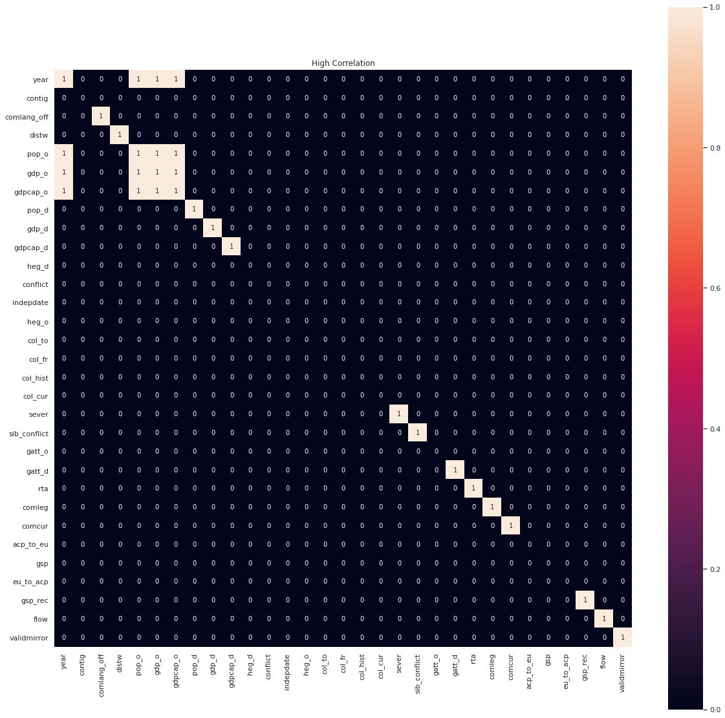
Data Processing
The following Highly correlated features will be removed from dataset:
year and gdp_o
year and pop_o
year and gdpcap_o
gdp_o and pop_o
gdocap_o and pop_o

Slide 9
Data cleaning
Dropping the features with more than 50 percent missing values('indepdate', 'conflict’).
Replacing NaN with 0 in dataset.
Replacing missing values with simple imputer

Slide 10
Regression Models
Decision Tree
Is a simple machine learning model for getting started with regression tasks. A decision tree is a flow-chart-like structure, where each internal (non-leaf) node denotes a test on an attribute, each branch represents the outcome of a test, and each leaf (or terminal) node holds a class label. The topmost node in a tree is the root node (see here for more details(see here for more details).
Random Forest
Is a meta estimator that fits a number of classifying decision trees on various sub-samples of the dataset and uses averaging to improve the predictive accuracy and control over-fitting. (see here for more details).
Lasso regression
Linear regression refers to a model that assumes a linear relationship between input variables and the target variable.
With a single input variable, this relationship is a line, and with higher dimensions, this relationship can be thought of as a hyperplane that connects the input variables to the target variable. The coefficients of the model are found via an optimization process that seeks to minimize the sum squared error between the predictions (yhat) and the expected target values (y).

Slide 11
Regression Models
Gradient Tree Boosting
Gradient Tree Boosting or Gradient Boosted Decision Trees (GBDT) is a generalization of boosting to arbitrary differentiable loss functions. GBDT is an accurate and effective off-the-shelf procedure that can be used for both regression and classification problems in a variety of areas including Web search ranking and ecology.
XGBoost stands for Extreme Gradient Boosting.
It is a performant machine learning library based on the paper Greedy Function Approximation: A Gradient Boosting Machine, by Friedman It is an open source machine learning library providing a high-performance implementation of gradient boosted decision trees. It is originally written in C++ and is comparatively faster than other ensemble classifiers. It belongs to a family of boosting algorithms and uses the gradient boosting (GBM) framework at its core. XGBoost implements a Gradient Boosting algorithm based on decision trees. So, to understand XGBoost completely, we need to understand Gradient Boosting Algorithm .

Slide 12
Comparing Models
Cross validation for regression models with train and test data
Mean Absolute Error (MAE), Mean RMSE,and Error standard deviation of two models calculated.

Slide 13
Comparing Results
Model | Mean Absolute Error (MAE)
XGBoost | 678323.6161
Lasso | 971904.6833
GDecisionTree | 916194.8057
RandomForest | 672662.685
Models | Mean RMSE | Error std deviation
Random Forest | 0.01154 | 0.000205
XGBRegressor | 0.012678 | 0.00046

Slide 14
Future improvements
Feature engineering
Compress features, reduce overfitting and
noise and increase efficiency and performance

